Slide 1

RFI at Low Frequencies
Nivedita Mahesh
David and Ellen Lee Postdoctoral Fellow
California Institute of Technology
In collaboration with: Gregg Hallinan, Judd Bowman, Danny Jacobs, Joe Lazio
RFI 2025

Slide 2
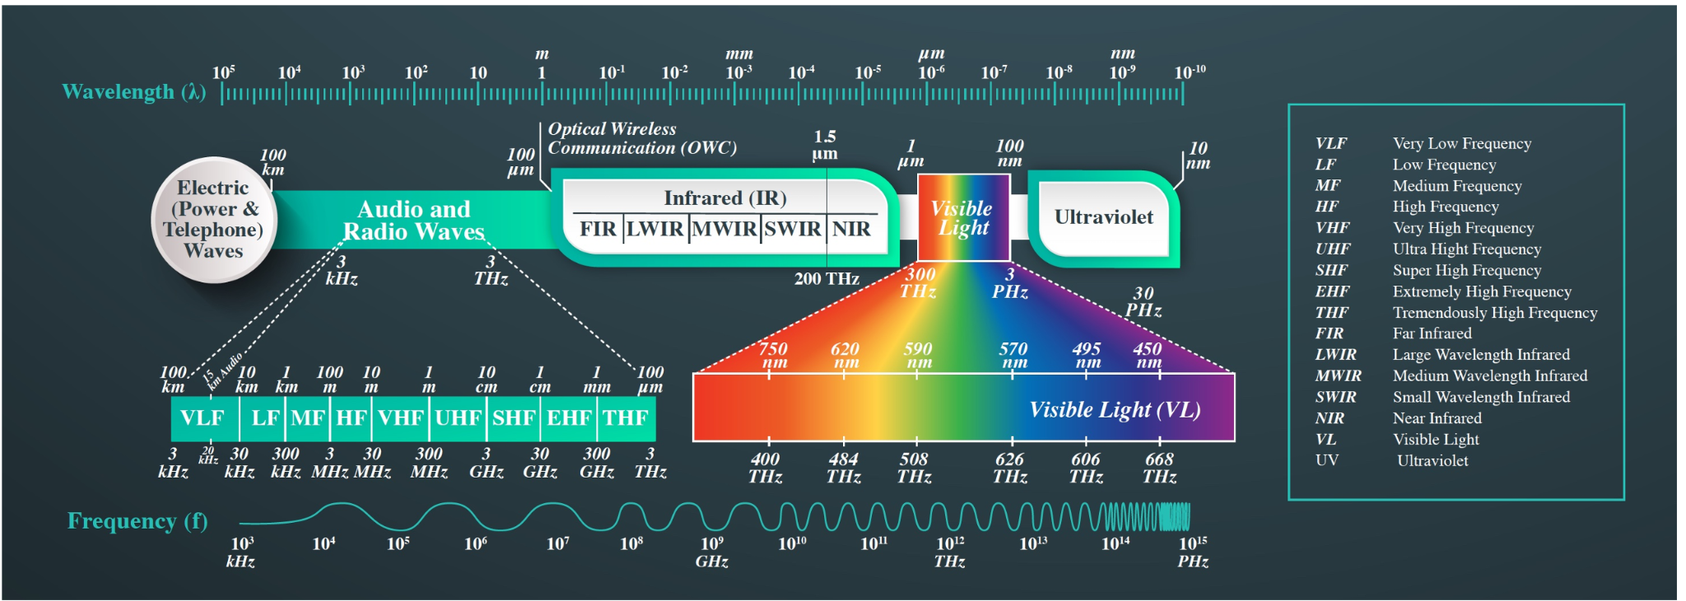
What do I mean by Low frequencies?
Celik et al. 2022 IEEE
~100 kHz - 330MHz

Slide 3
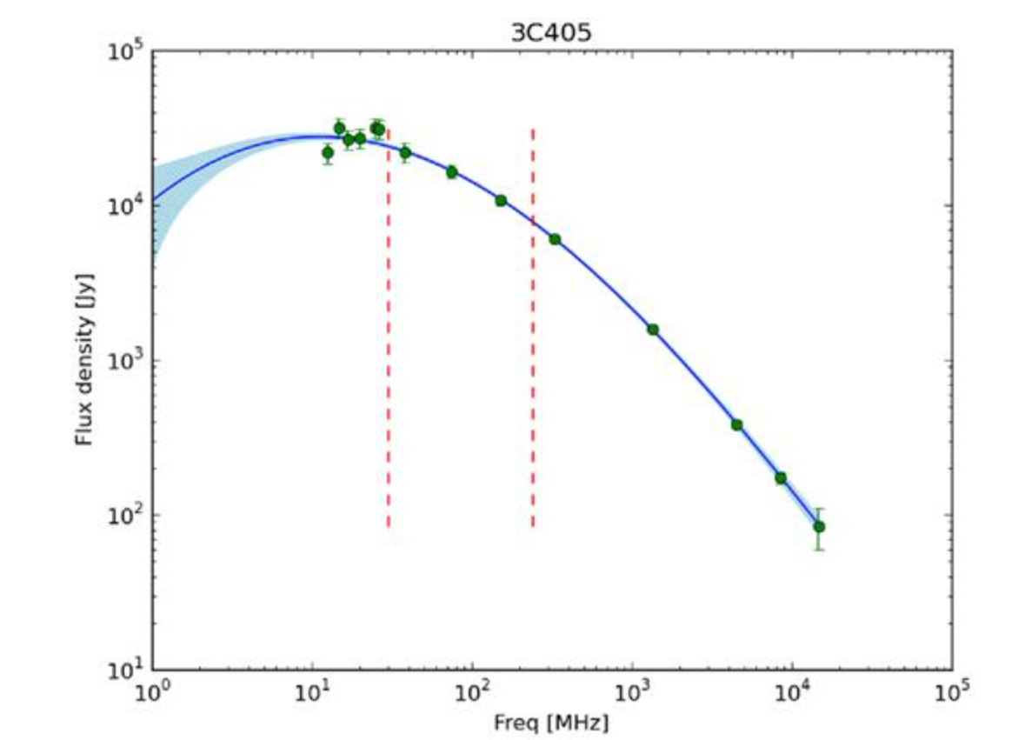
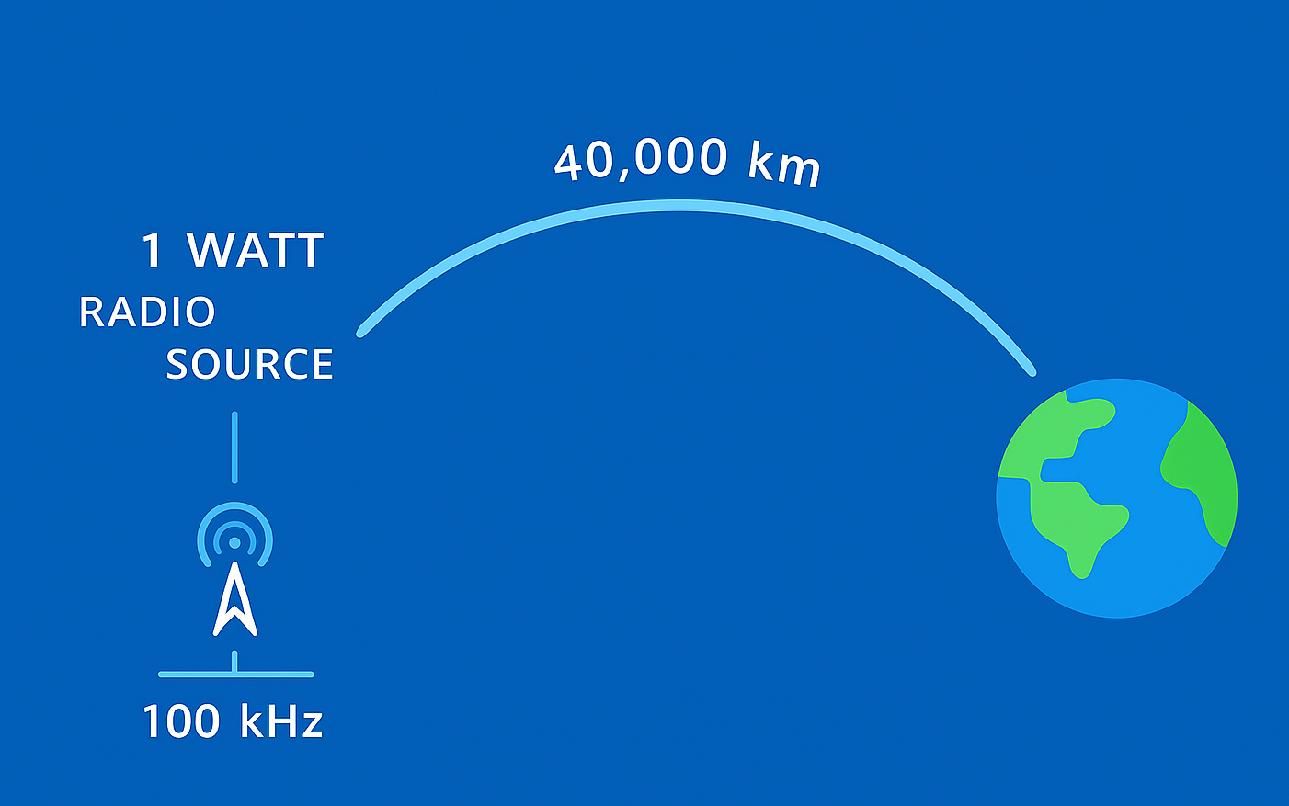
Celestial sources
Human-made transmitters
Spectral power density of
1 Watt transmitter @ 40,000Km
Spectral power density of Cyg A
~20kJy @ 75 MHz
~ 49kJy @ 75 MHz
Even the 2nd brightest radio source in sky < 1W transmitter at GEO

Slide 4
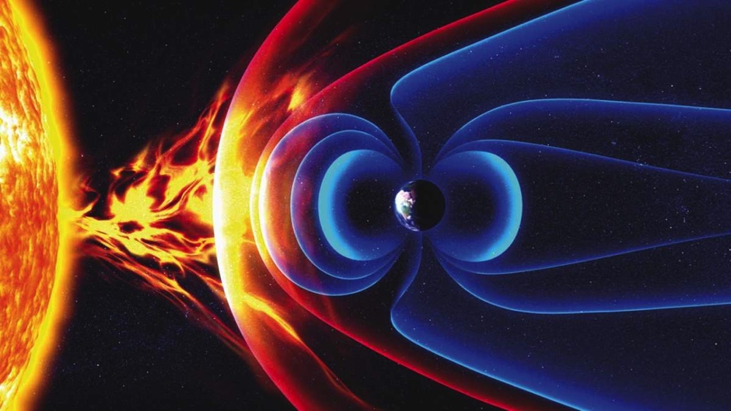
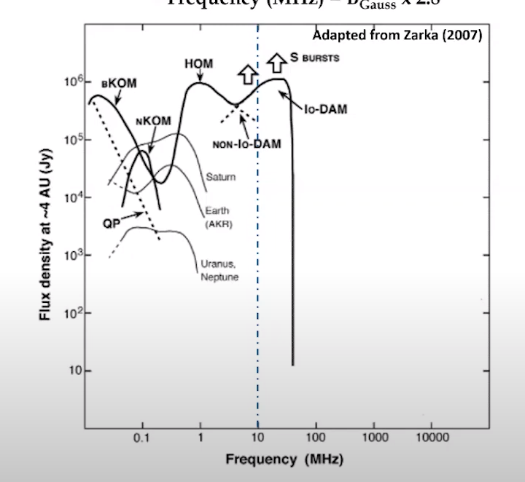
Why are radio astronomers so interested in the VHF band?
Detect exoplanet auroral emission - “Is there life on other planets?”

Slide 5
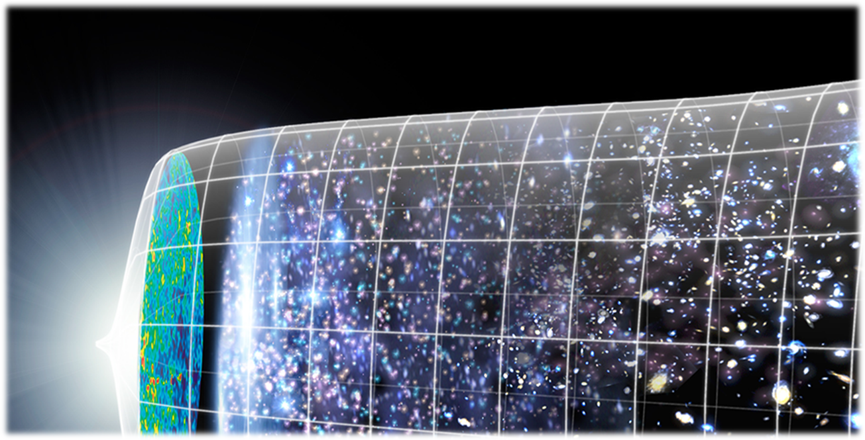
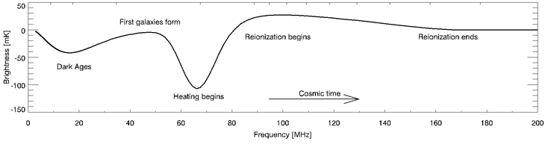
Why are radio astronomers so interested in the VHF band?
Detect exoplanet auroral emission
Measure the 21 cm power spectrum during the Epoch of Reionization and Cosmic Dawn - “How did it all began?”

Slide 6
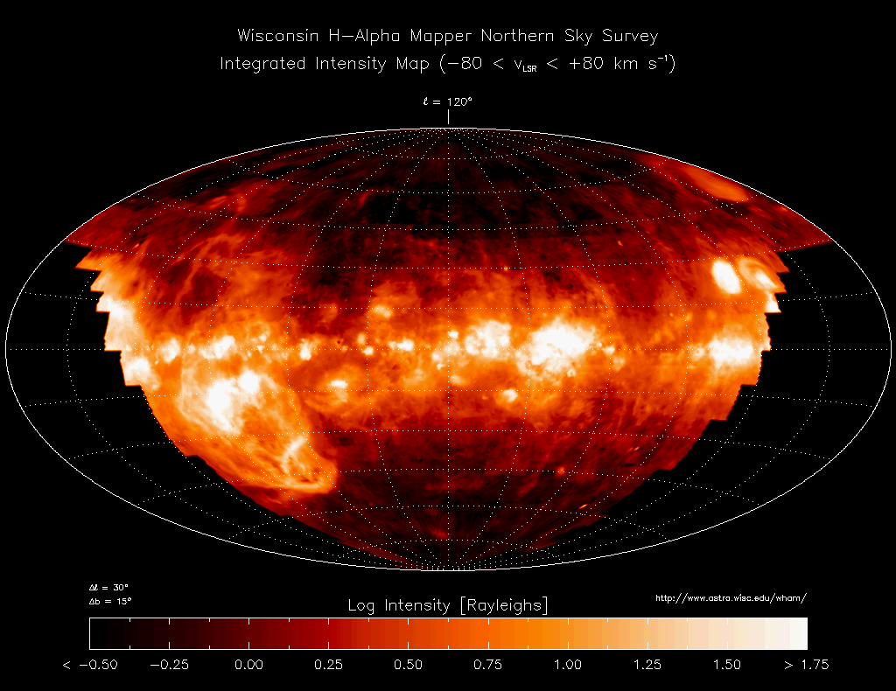
Why are radio astronomers so interested in the VHF band?
Detect exoplanet auroral emission
Measure the 21 cm power spectrum during the Epoch of Reionization and Cosmic Dawn - “How did it all began?”
Characterize the ISM

Slide 7
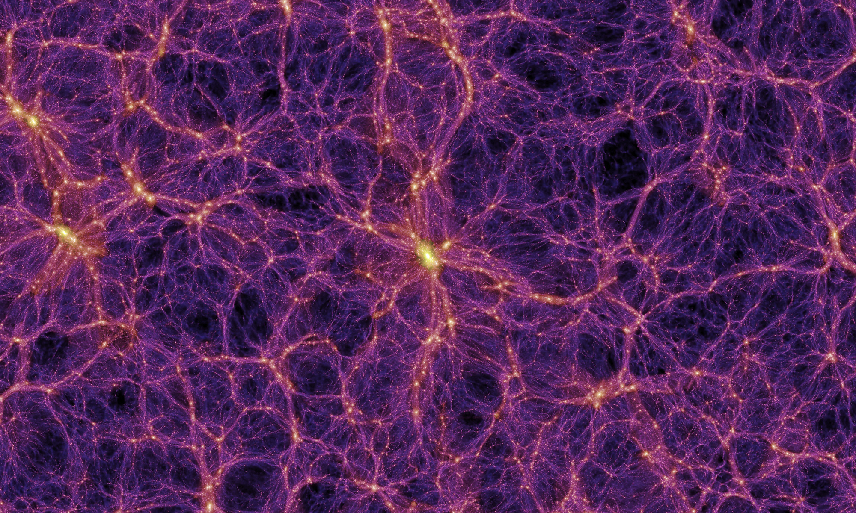
Why are radio astronomers so interested in the VHF band?
Detect exoplanet auroral emission
Measure the 21 cm power spectrum during the Epoch of Reionization and Cosmic Dawn - “How did it all began?”
Characterize the ISM
Measure the Cosmic Web

Slide 8
Why are radio astronomers so interested in the VHF band?
Detect exoplanet auroral emission
Measure the 21 cm power spectrum during the Epoch of Reionization and Cosmic Dawn - “How did it all began?”
Characterize the ISM
Measure the Cosmic Web
Catalog radio galaxies at low frequencies
Multimessenger astroparticle physics
Solar measurements
Fast time domain transients
Slow time domain transients
21 cm forest measurements
SETI
Spectral line measurements (RRLs, deuterium)
… & so many more science questions!

Slide 9
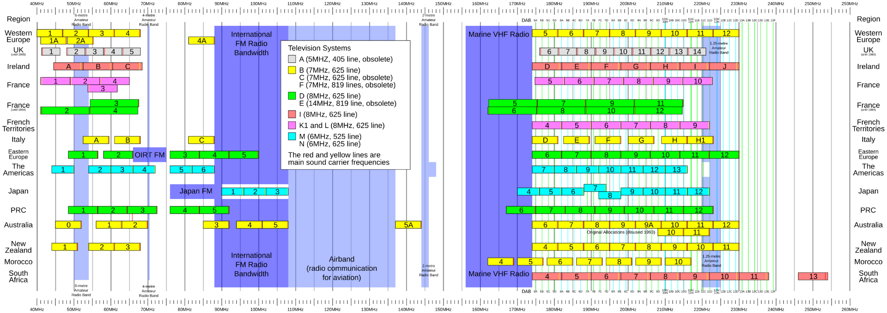
Strong Transmitters in the VHF band
VHF is a very populated band: TV, FM, radars, Aviation & marine communications, OrbComm…
40 MHz
250 MHz
Notes:
Analog switched off? For TV?

Slide 10
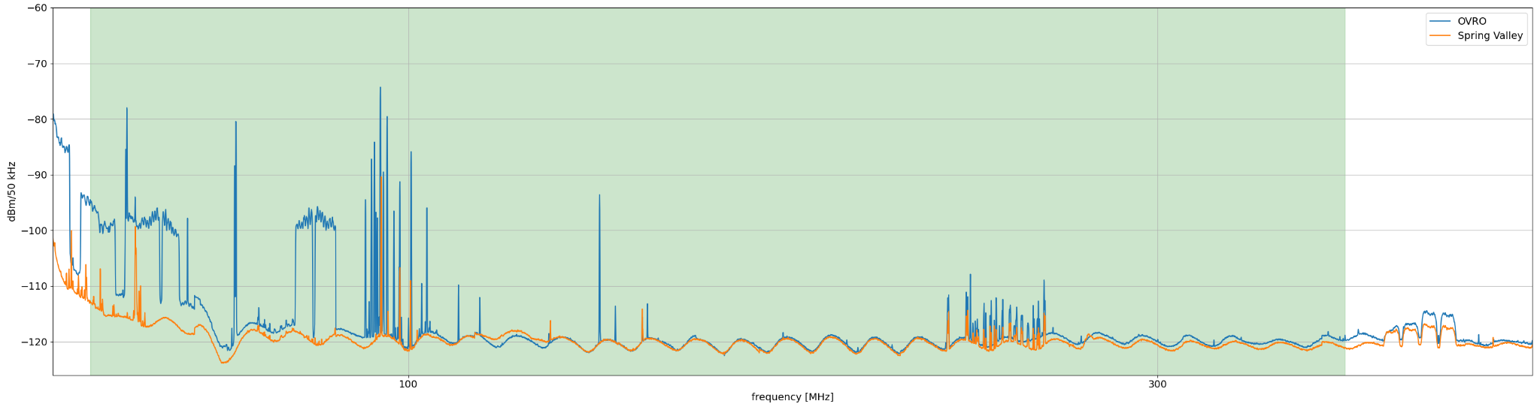
RFI at a few low-frequency observatories
Owens Valley Radio Observatory, CA. Home to: OVRO-LWA, DSA-110, COMAP…
Spring Valley, NV. Home to: DSA-2000
FM
OrbComm
Aviation communication
Credit: Greg Hellbourg

Slide 11
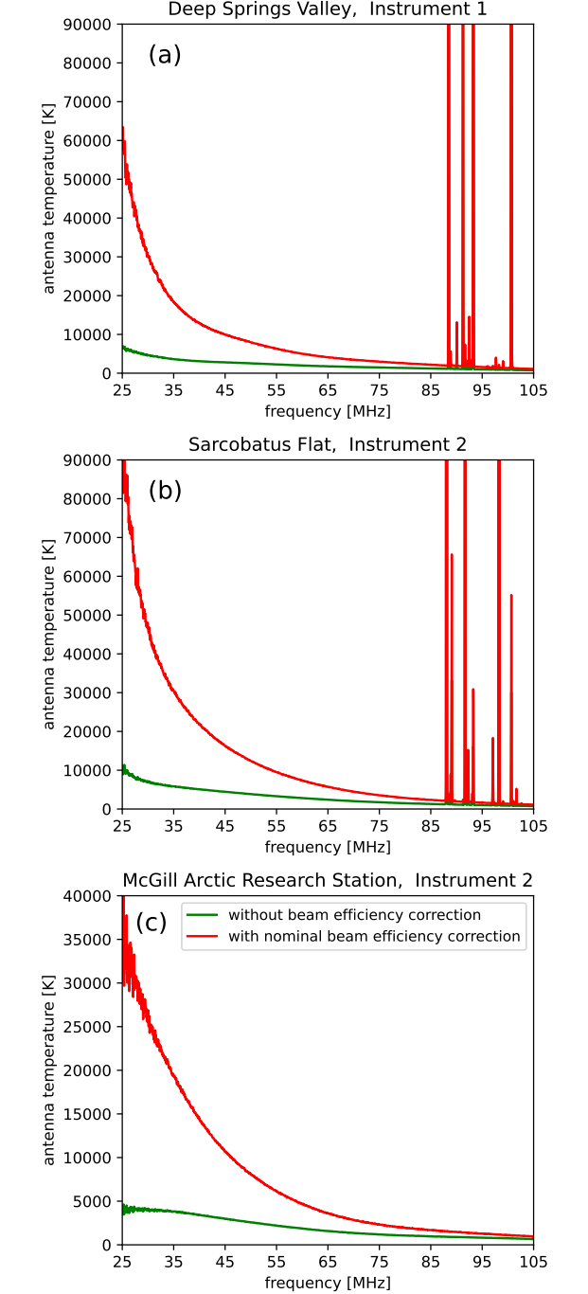
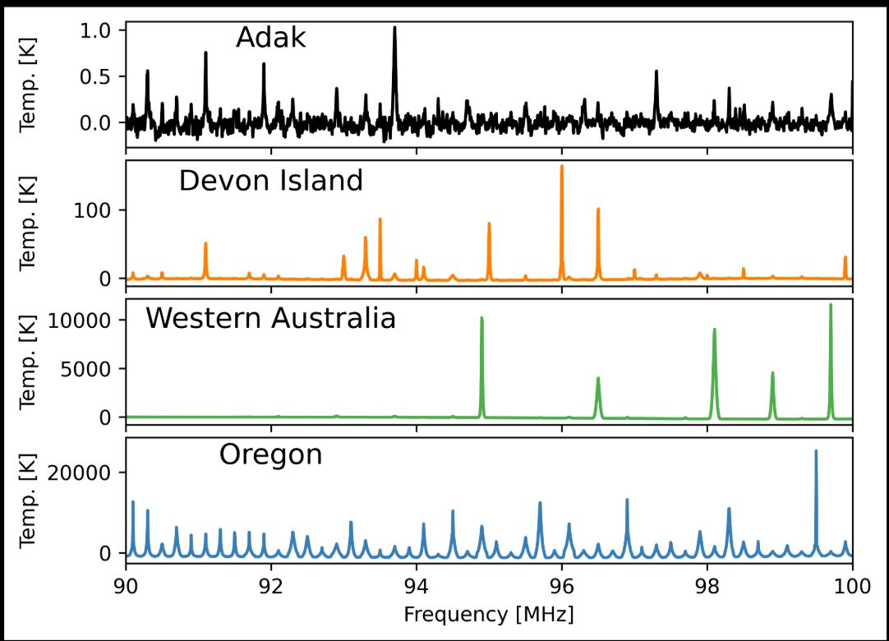
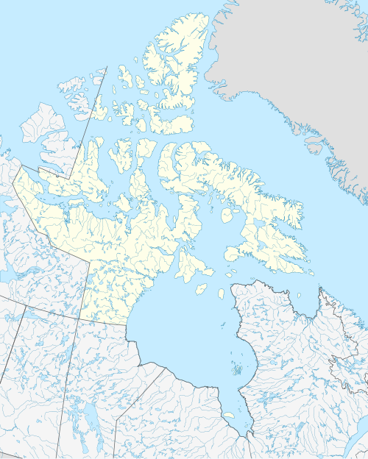
RFI comparison for MIST and EDGES sites
CA
Cosmology experiments looking for sub-kelvin signals
NA
Monsalve et al. 2022

Slide 12
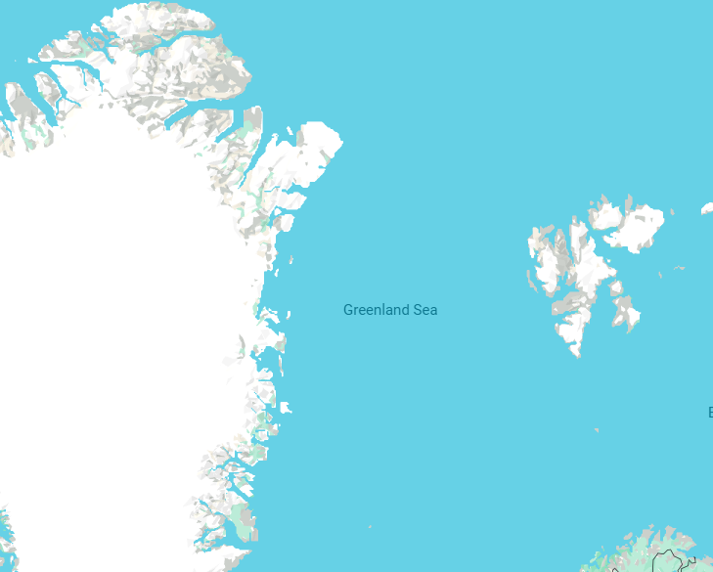
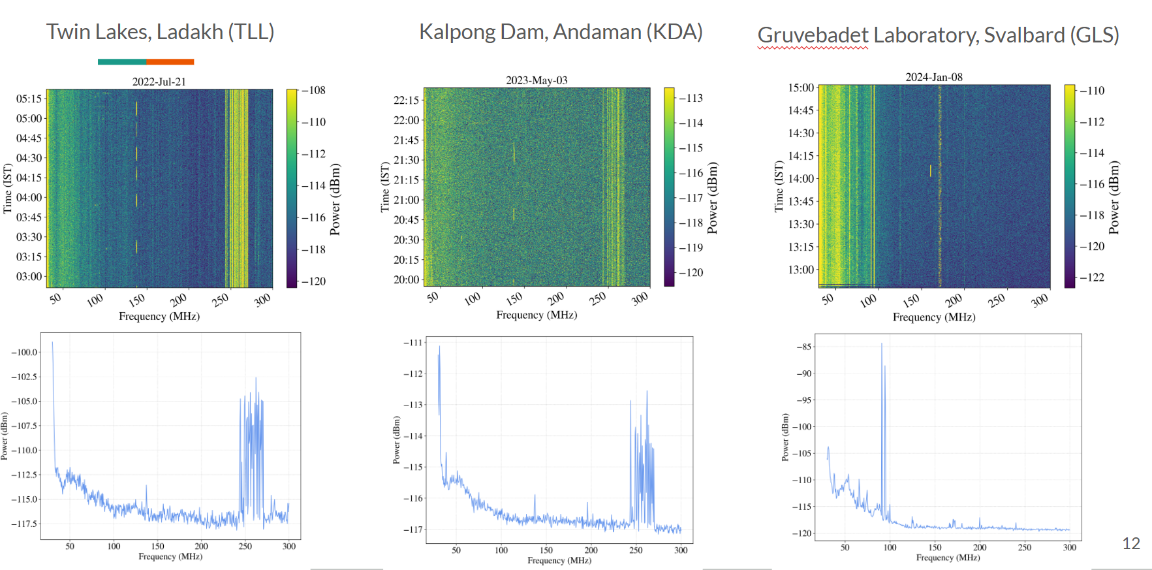
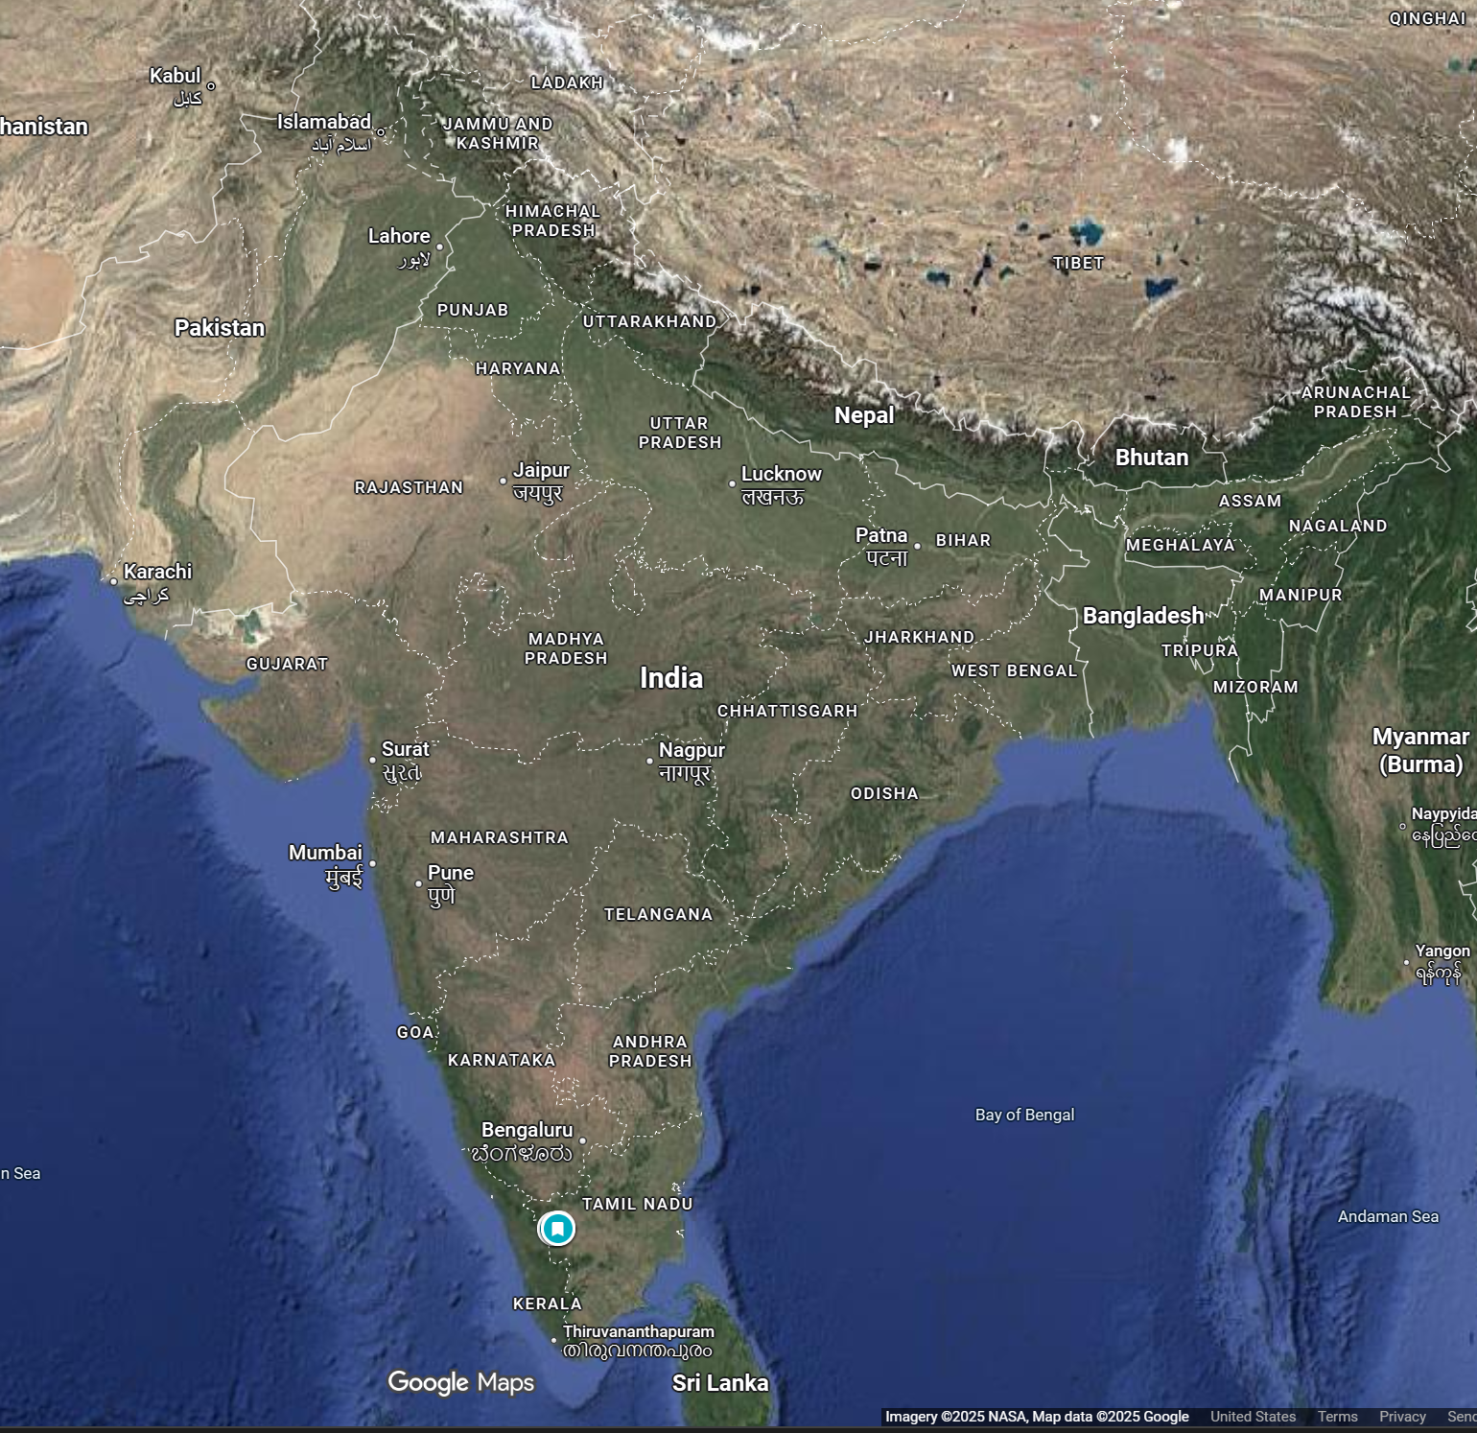
RFI Comparison between SARAS sites
MARS & Devon
Cosmology experiment looking for sub-Kelvin signals
Agarwal et al. 2023

Slide 13
Morphology of RFI with two datasets:
OVRO-LWA
EDGES

Slide 14
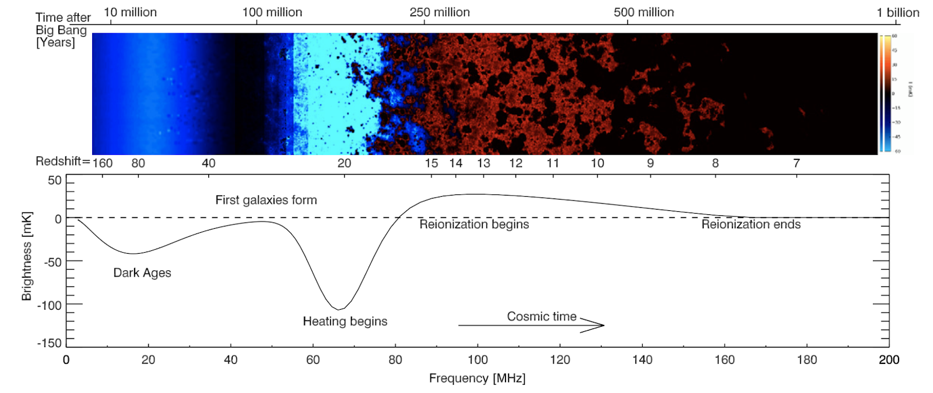
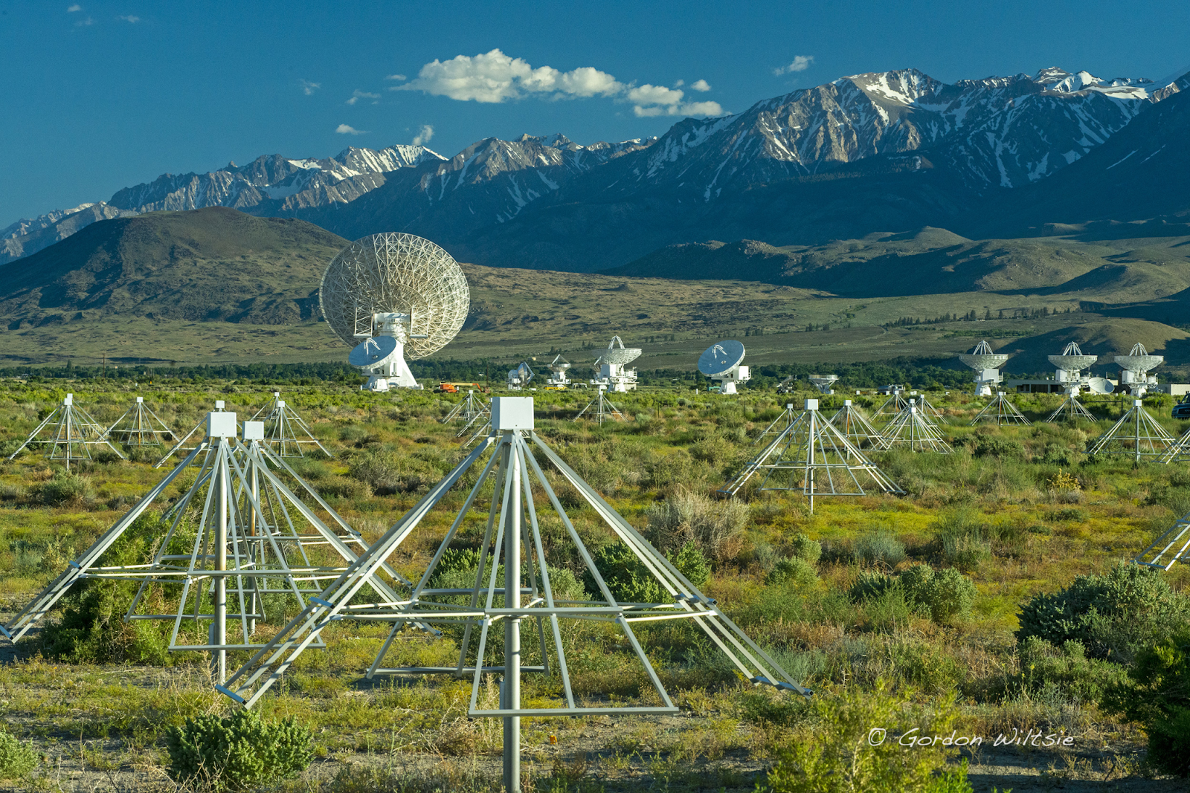
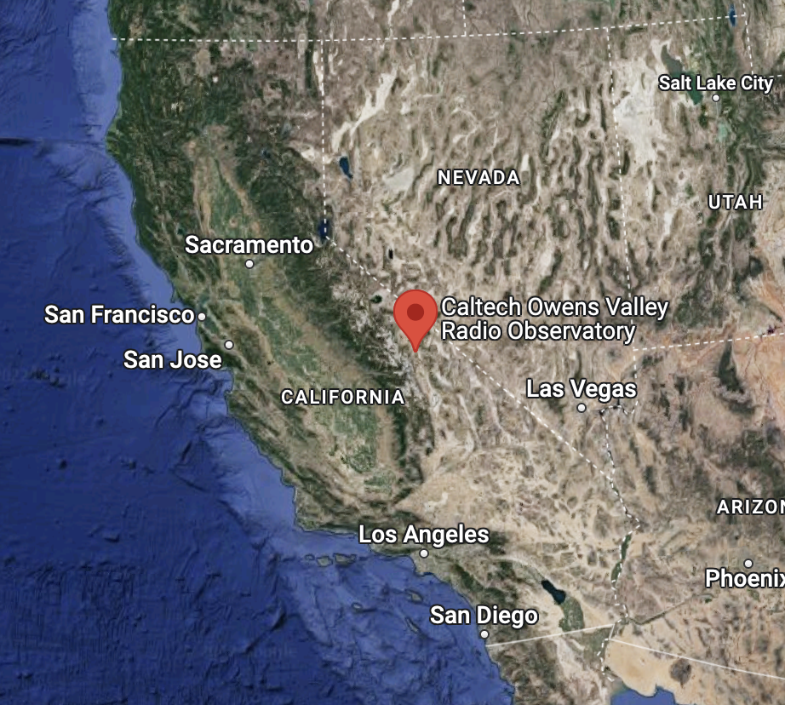
OVRO-LWA
Owens Valley Radio Observatory (OVRO) Long Wavelength Array in California
352 Dual-polarization widefield dipole antennas
Fully cross-correlated
12-85 MHz
Currently in its “Stage III” of operations

Slide 15
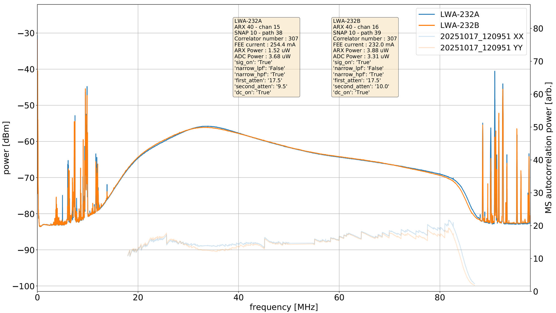
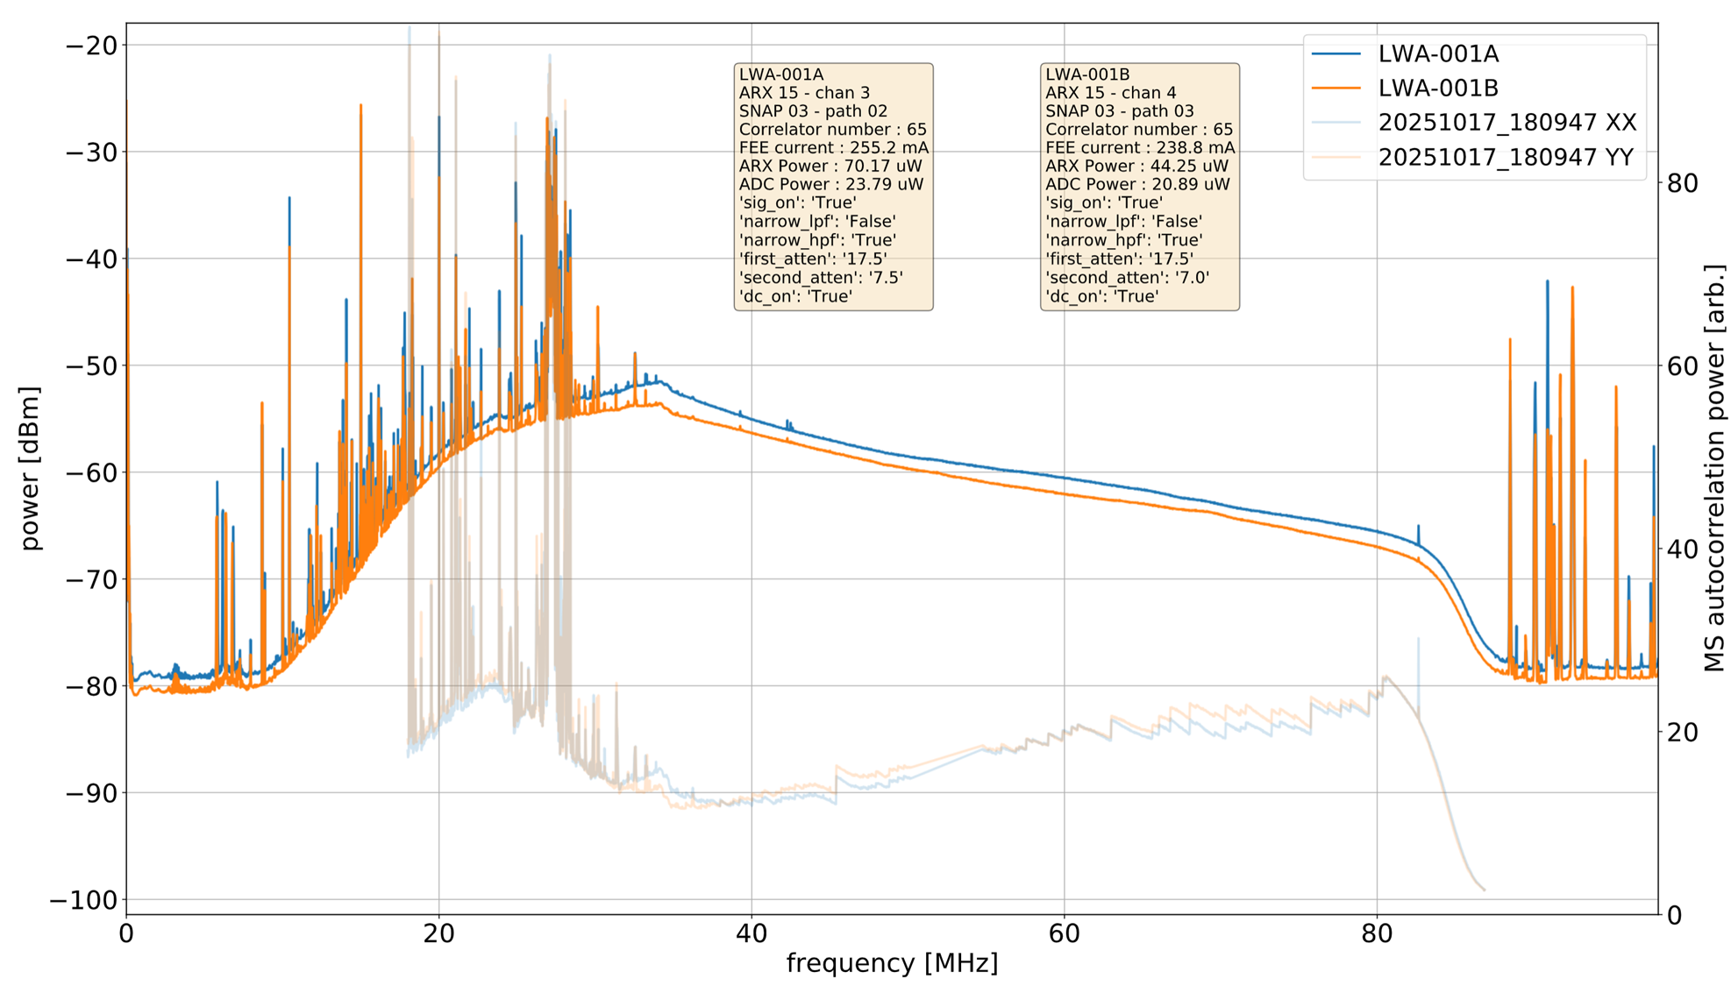
Morphology of RFI: OVRO-LWA data
Night time
Channel 6–27.025 MHz Considered to be the “Super Bowl”. It is a channel used by people with very powerful, illegally-amplified radios: “big” radios, 500 or 1,000 watt radios
Day time
Short wave
FM
Notes:
(This has nothing to do with the football Super bowl.)

Slide 16
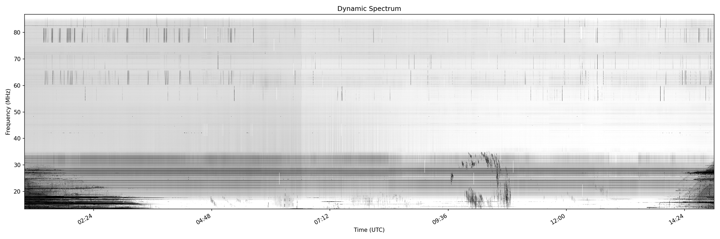
Morphology of RFI: OVRO-LWA data
Reflections of aircraft, meteors, satellites
All baselines
Power line arcing - horizon RFI
Short wave RFI

Slide 17
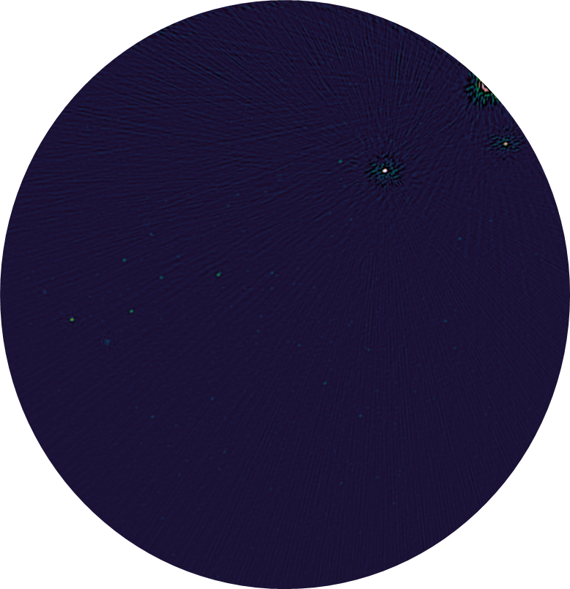
Morphology of RFI: OVRO-LWA data
How does power line arcing show up in images?
Imaged during bad power line arcing
Centered on 23 MHz; BW ~ 5MHz

Slide 18
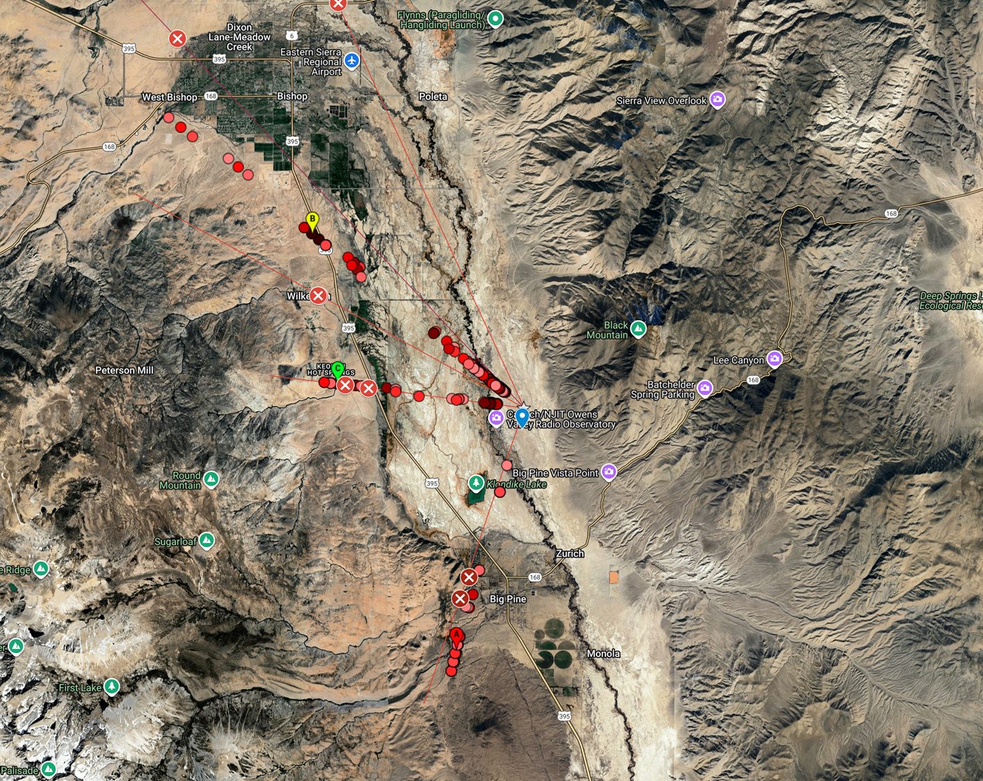
Identified and dealt with most of the power line arcing issues
OVRO group working with the Southern California Edison company
Fixed broken insulators on the power lines

Slide 19
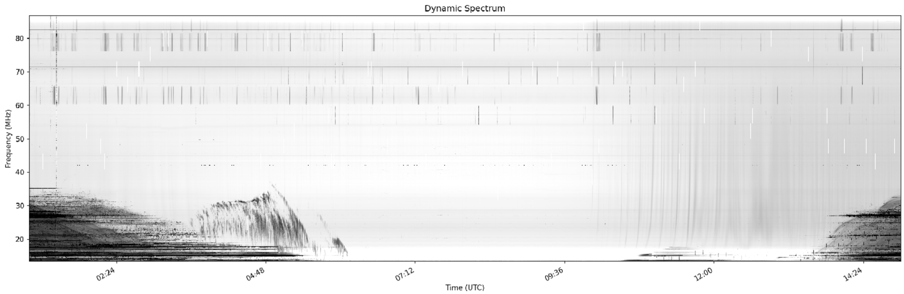
Morphology of RFI: OVRO-LWA data
In most recent data, RFI to power line arcing has reduced!
March 6th 2025

Slide 20
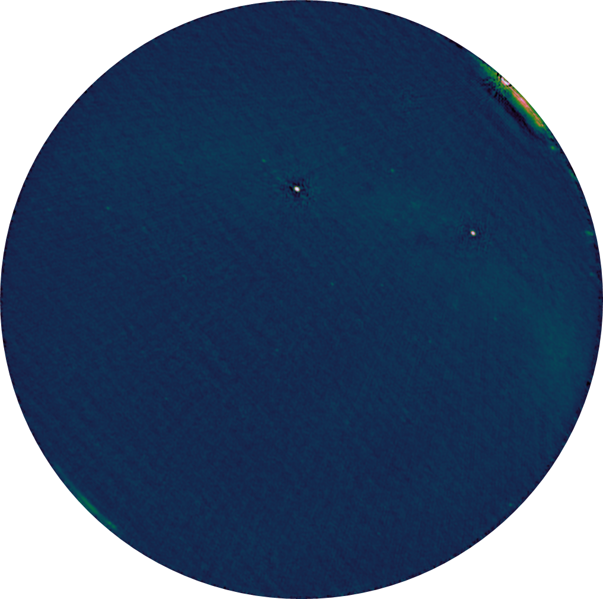
Morphology of RFI: OVRO-LWA data
How does short wave show up in images?
Imaged around sunrise.
Centered on 23 MHz; BW ~ 5MHz

Slide 21
Morphology of RFI: OVRO-LWA data
And we start to see real astronomical data
March 6th 2025
Scintillations of bright A team sources
Jovian bursts
Sky data

Slide 22

Morphology of RFI: OVRO-LWA data
Jupiter bursting: real data

Slide 23
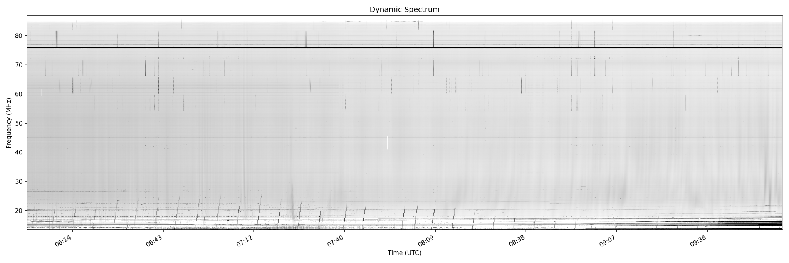
Morphology of RFI: OVRO-LWA data
Ionosondes → measure the ionosphere. Radars @ <30MHz
Ionosondes

Slide 24
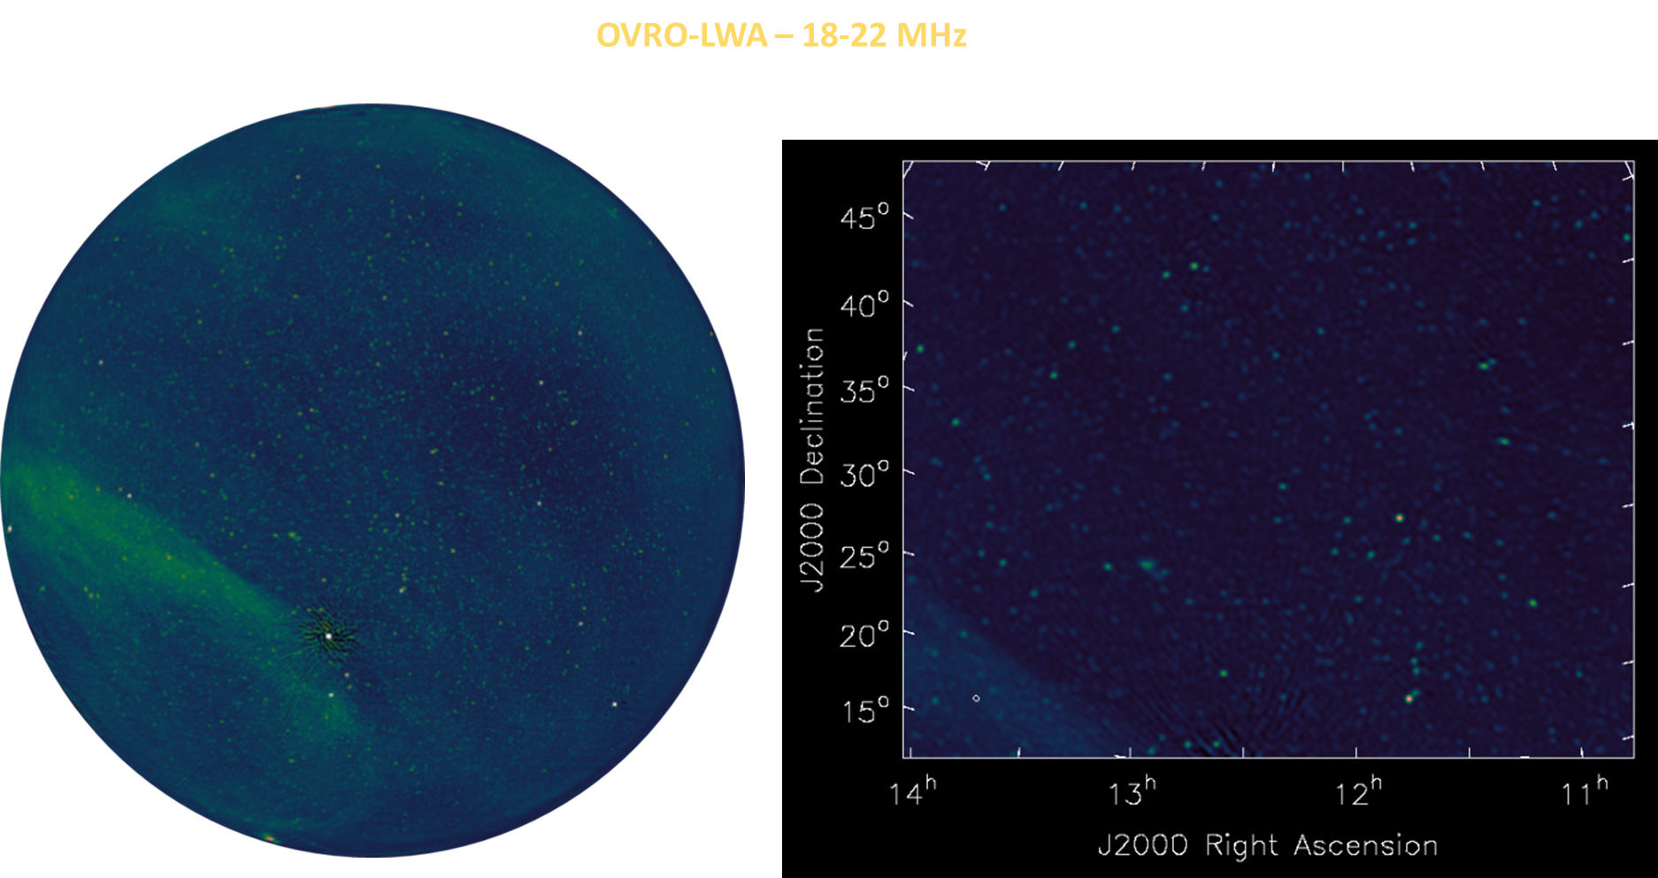
OVRO-LWA: Successfully achieve science quality data
After all the efforts & pipeline implementations:
Power line repairs
night time data to minimize CB & short waves
Increased individual antenna quality
AOFlagger
18MHz - 22MHz
Credit: Gregg Hallinan

Slide 25
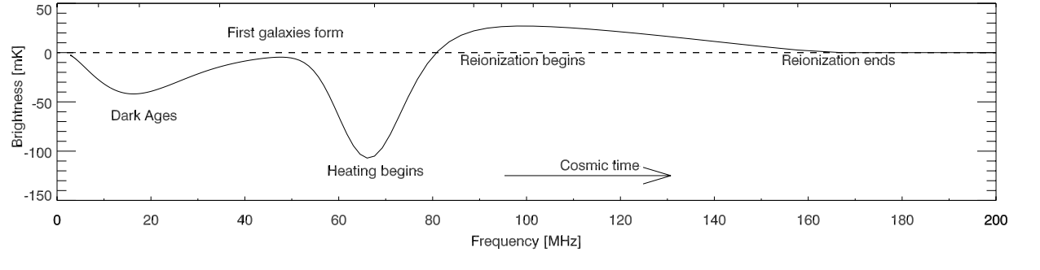
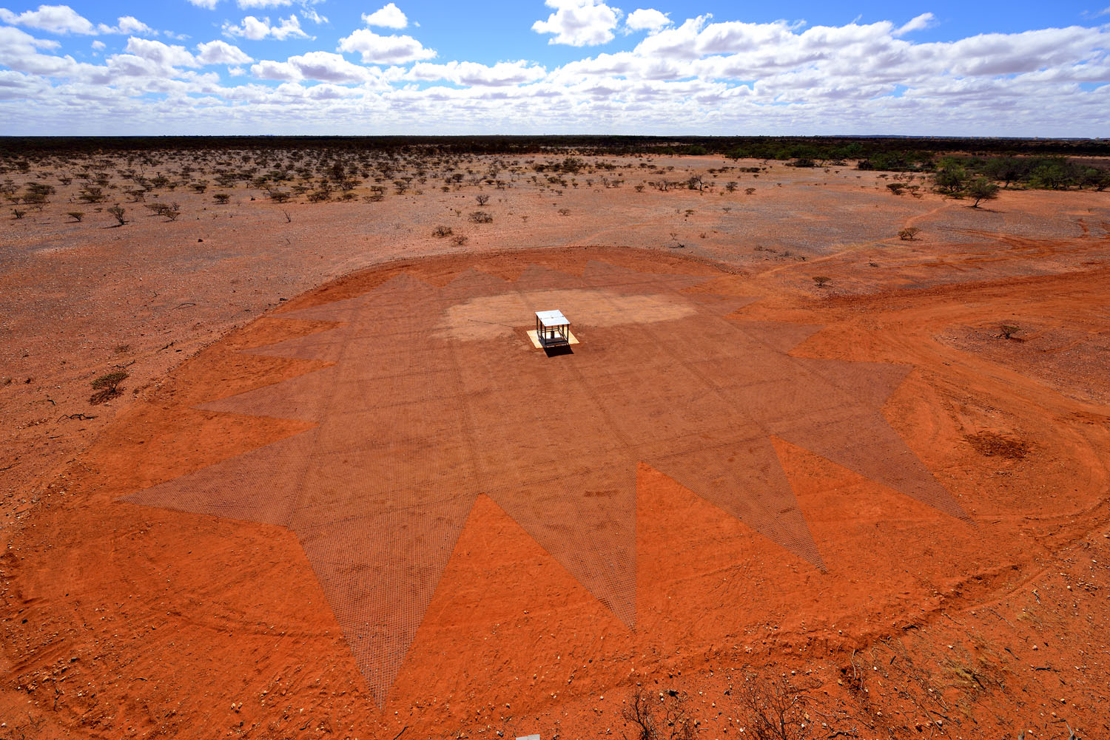
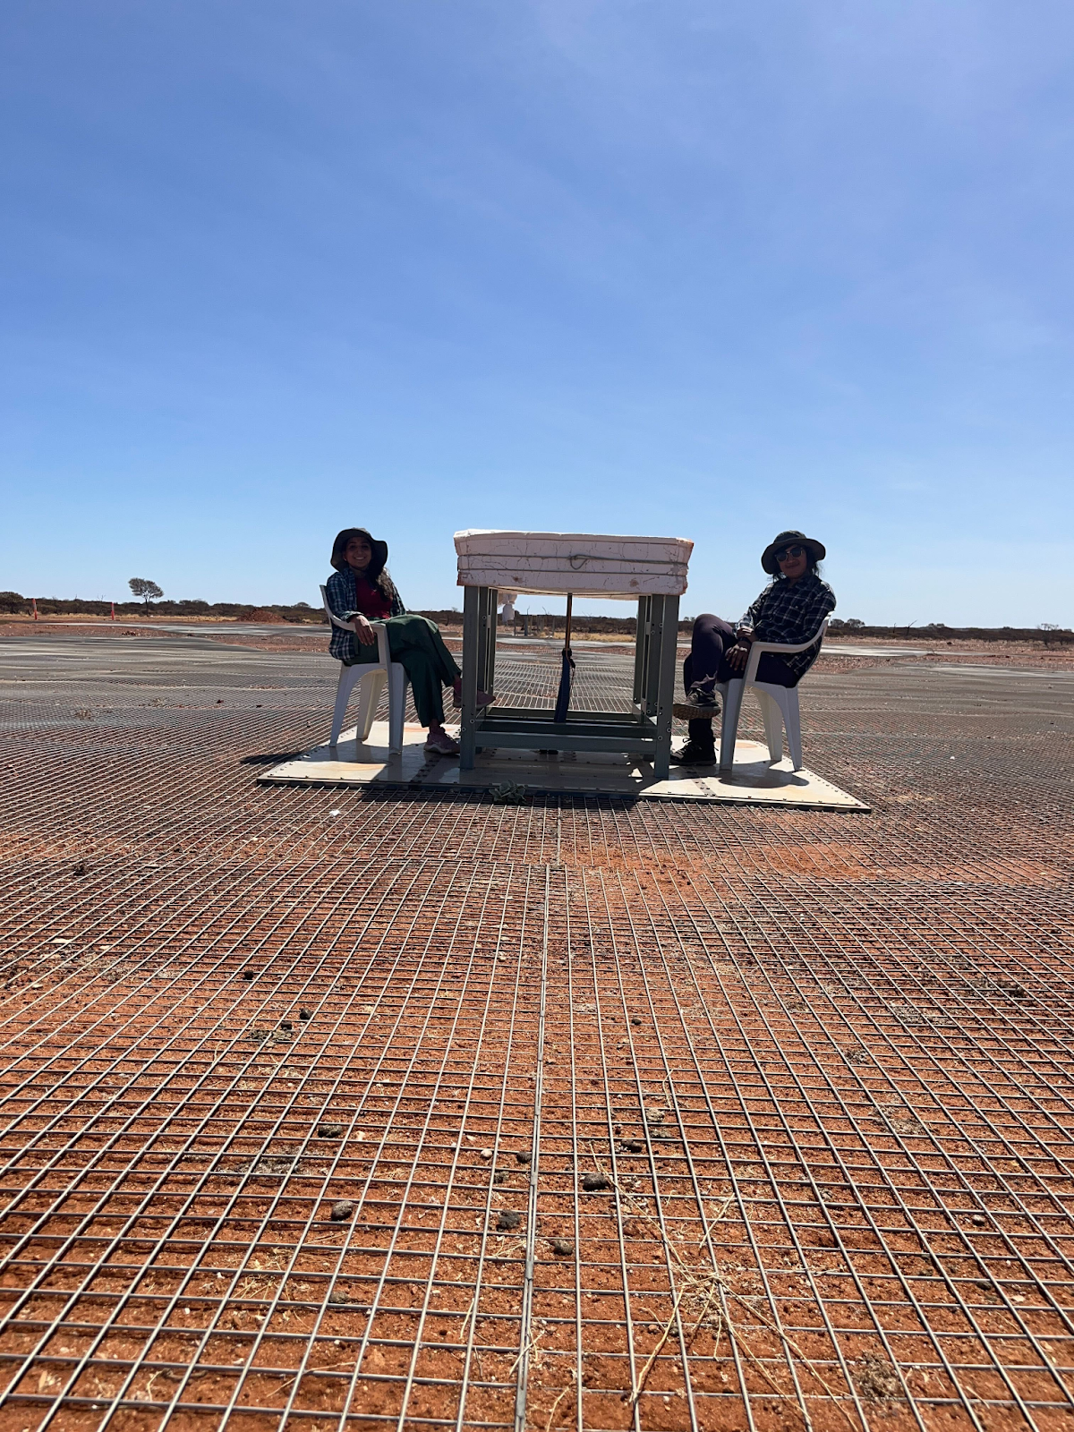
EDGES
Experiment to Detect the Global EoR Signature
Single absolutely calibrated radiometer
Located in remote areas of Western Australia
Operates between 50 - 200 MHz
The first experiment to report a Cosmic Dawn detection (Bowman et. al. 2018)
Feb 2024

Slide 26
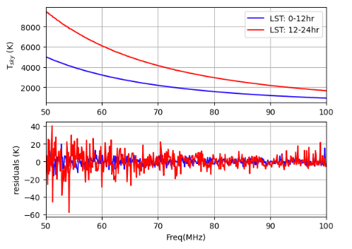
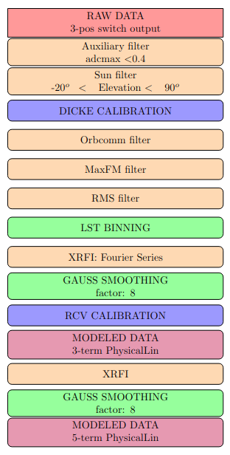

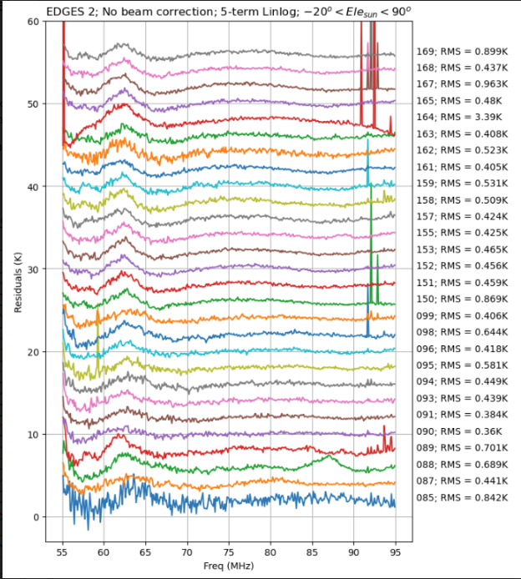
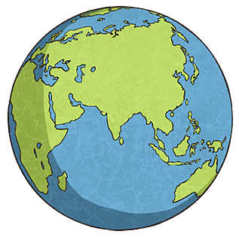
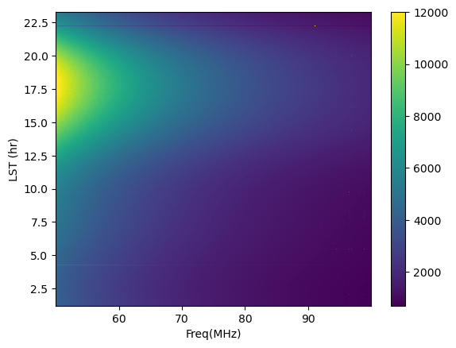
Morphology of RFI: EDGES data
Days:
2024_085 to 2024_170

Slide 27
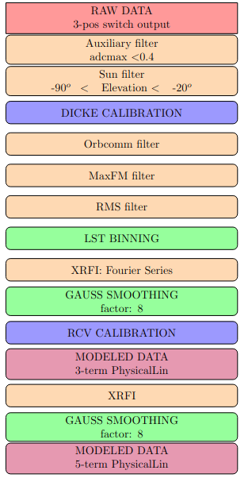
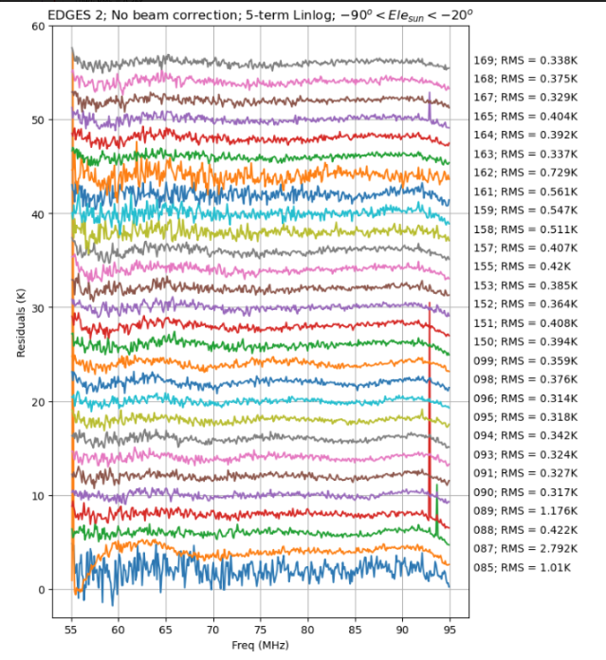
Morphology of RFI: EDGES data
Days:
2024_085 to 2024_170

Slide 28
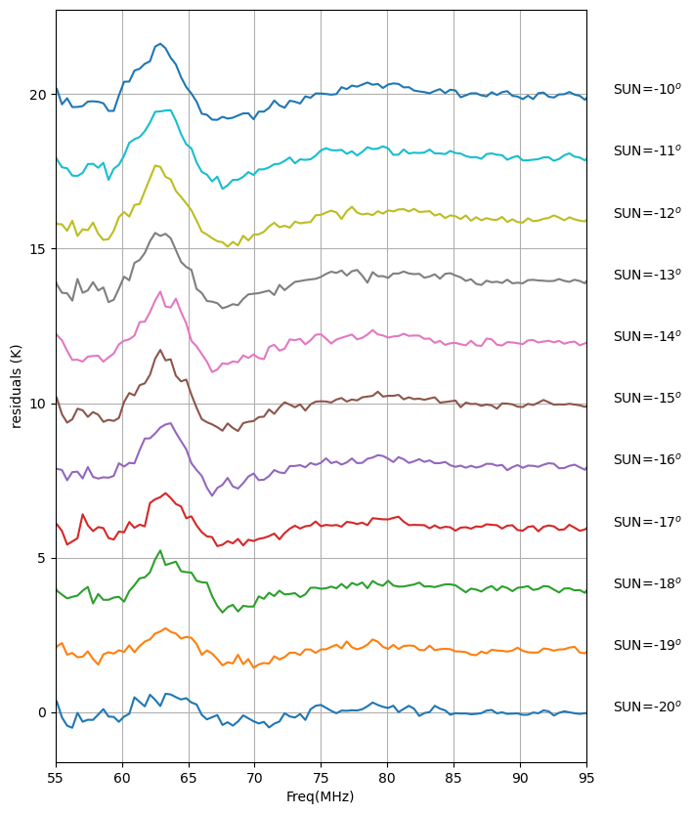
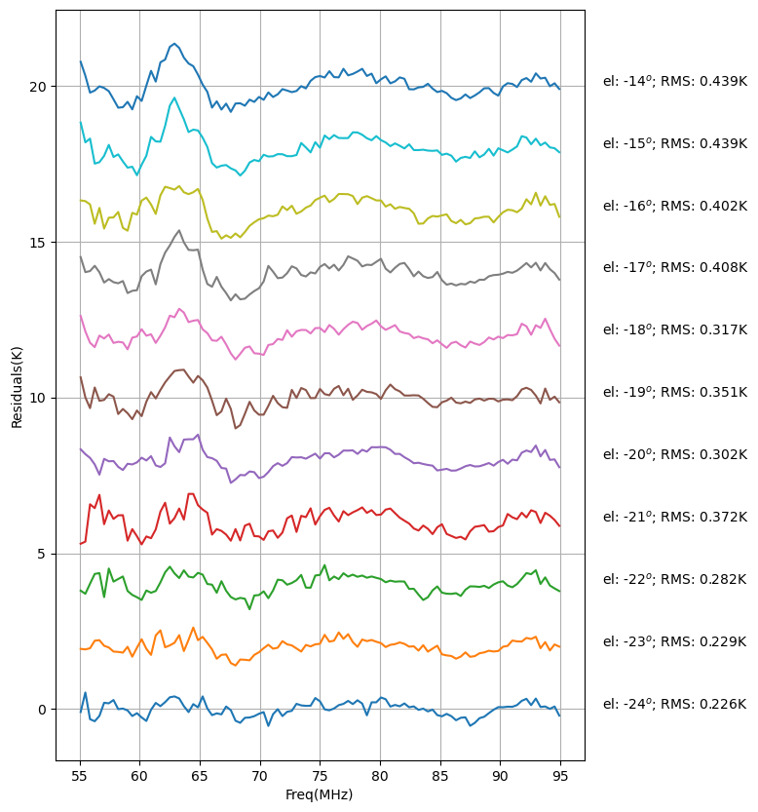
Morphology of RFI: EDGES data
EDGES - 3
EDGES - 2 45 deg
EDGES - 2 45 deg
Tracking down the 63 MHz RFI
500 Km
-22º
6378 Km

Slide 29
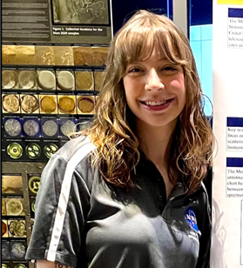
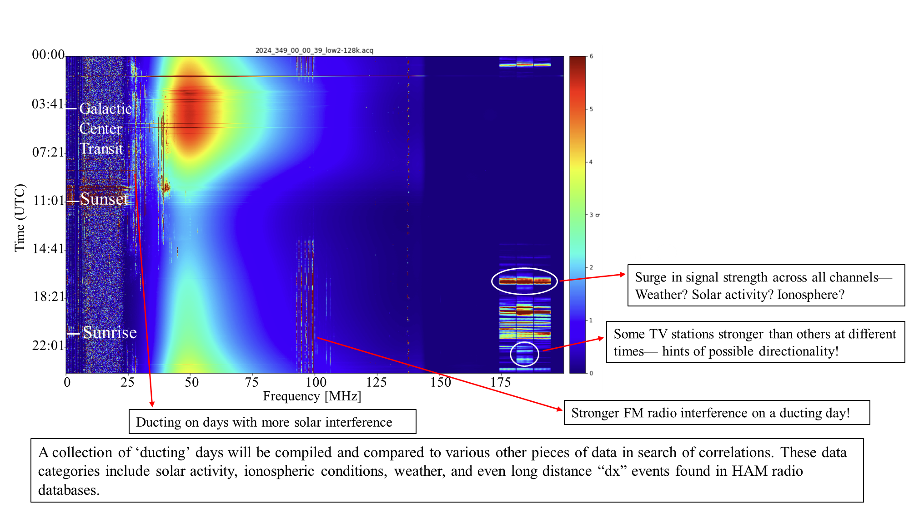
Morphology of RFI: EDGES data
Tropospheric ducting @ SKA-Low site

Slide 30
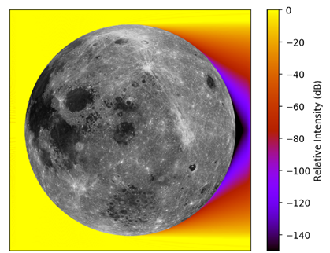
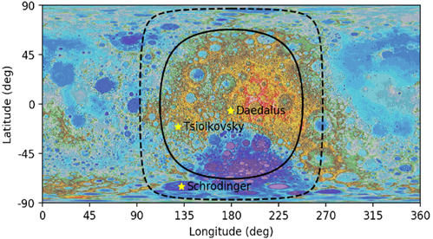
An option: Going to the Moon for Low-frequencies
Simulations of the Radio Environment of the Moon, Basset et.al, CU Boulder
Two-dimensional numerical electrodynamics simulations show that the relative intensity of terrestrial radio waves incident on the Moon is highly attenuated behind the farside.
The “radio quiet” region at 100 kHz (solid) and 10 MHz (dashed) defined by ≥ 80 dB attenuation plotted over a map of the lunar surface.
Need to go to Neptune to get the equivalent free-path attenuation

Slide 31
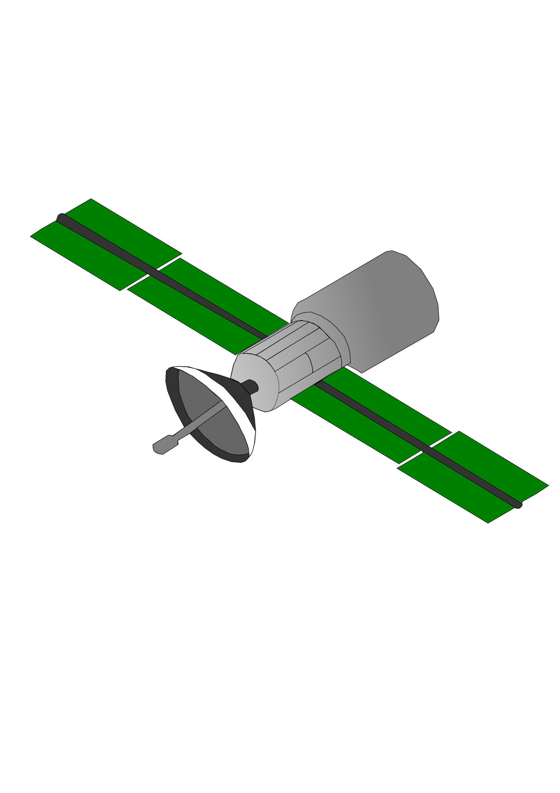
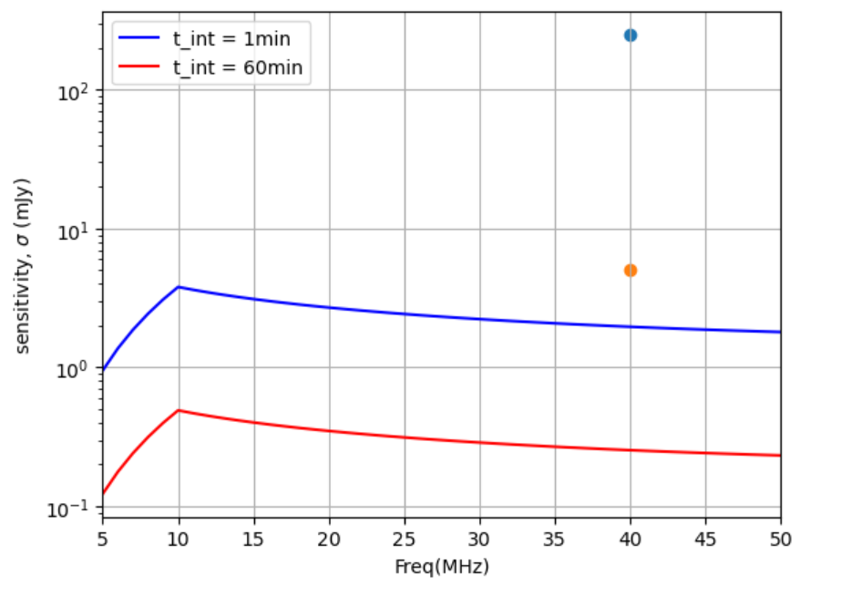
Even for the Moon there is an URGENCY
The spectral power flux density of the broadband UEMR [from Starlink satellites at an average altitude of 500 km] varies from 15 to 1300 Jy, between 56 and 66 MHz [Bassa et al. 2024]
Assuming UEMR of 100Jy(from 480Km) @ 40MHz
Starlink-like @ 10,000 Km
[Zhang et al. 2025] report the detection and analysis of broadband radio emissions from Starlink satellites below 100 MHz using NenuFAR.
...with flux densities ranging from 2 Jy to 261 Jy.
@ 70,000 Km (apolune)
3𝞂
20𝞂
If there are satellites like Starlink placed in lunar orbit, the farside radio-quiet zone is in great danger!

Slide 32
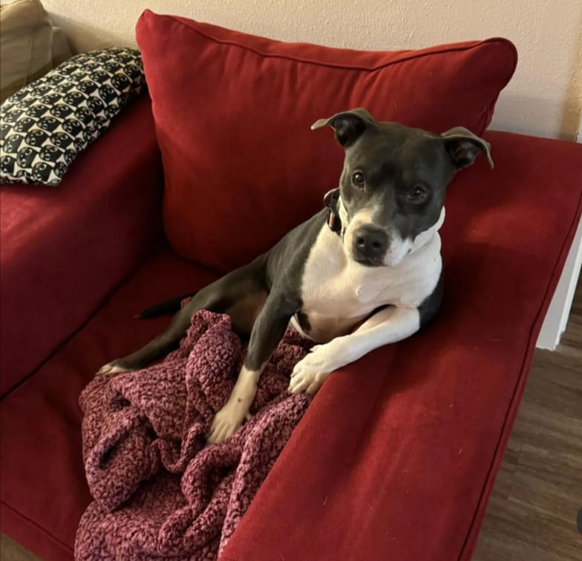




Thank you for listening!
Questions for me?
QUESTIONS?
Contact info:
nmahesh@caltech.edu
Nivedita Mahesh
@nivedita_mahesh
@dr.niveditamahesh

Slide 33
Discussions & key takeaways

Slide 34
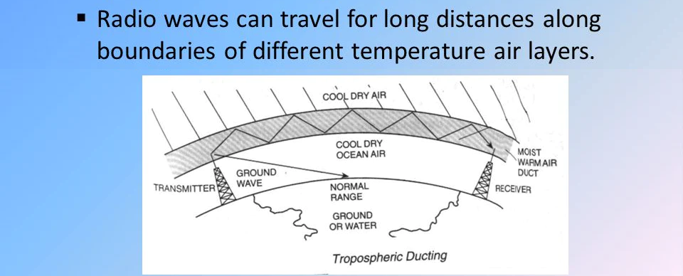
Morphology of RFI: EDGES data
Tropospheric ducting @ SKA-Low site

